Slide 1
Product Life Cycle
Name
Course
Date

Slide 2
Introduction
Case: I’m the marketing manager of Samsung Group. I am tasked to foresee the success of the company’s products. As a marketing manager, I monitor the stages of Product Life Cycle (PLC) and adjust the different stages of development to ensure that the final product is of high quality, and satisfy the customer needs.
At each stage, I’m required to make decision regarding our product, pricing strategy, managing competition, as well as ensure our company maintain profit.
Notes:
In this page, I have summarized the case I am tasked with. I am the marketing manager of Samsung group and am required to make decisions that will help the company realize profit and remain competitive.

Slide 3
Goals of the Study
Help develop better understanding of the steps involved in product development.
Discuss the role of pricing strategy in marketing.
Expound on the role of marketing managers in product development.
Outline and explain the various stages of product life cycle
Helps appreciate the importance of PLC
Notes:
The aim of this study is to Discuss the role of pricing strategy in marketing, Help develop better understanding of the steps involved in product development, Expound on the role of marketing managers in product development, helps appreciate the importance of PLC, and outlines and explain the various stages of product life cycle
As a marketing manager I need to have the knowledge on product lifr cycle as well as understand the marketing and pricing sttrategy

Slide 4
Concept of Product Life Cycle
PLC is a concept that looks at the different stages of new and existing product development; from when the concept is developed to when the product reaches the consumer.
PLC checks the progress of a product from one stage to another and by doing so, changes can be made at each stage to improve efficiency and quality of the product if need be.
PLC factors certain parameters such as market research, competitive pricing, quality, and customer demand.
Notes:
PLC is a concept that looks at the different stages of new and existing product development; from when the concept is developed to when the product reaches the consumer.
PLC checks the progress of a product from one stage to another and by doing so, changes can be made at each stage to improve efficiency and quality of the product if need be.
PLC factors certain parameters such as market research, competitive pricing, quality, and customer demand.

Slide 5
Significance of Product Life Cycle
The firm develop ideas of product needs and its position in the market.
Ensure a company is on the growth path and to sustain its revenues.
PLC acts a forecasting tool. Can be used to predict future of a product or it performance in the future.
Aids in product promotion as the company is able to determine the most effective method of product promotion.
Quality control- PLC ensures the final product as it is tracked along the way and changes are made along the way to maintain quality.
Notes:
Product life cycle has the following benefits
Enables the firm develop ideas of product needs and identify its position in the market.
Ensure a company is on the growth path and to sustain its revenues.
PLC acts a forecasting tool. Can be used to predict future of a product or it performance in the future.
Helps in making the customer aware of the product through promotion, brand awarwenss, and campaign through existing medium sach as advertisement.
Quality control- PLC ensures the final product as it is tracked along the way and changes are made along the way to maintain quality.

Slide 6
Significance of Product Life Cycle (cont.)
If the PLC is not monitored, the company is likely to Experience declining sales, low quality product, reduced tolerance to competition and it won’t be able to meet customer needs and would likely lead to loss of market share (Baker, 2016).
For example, when Samsung Group introduced Galaxy note 8 in the market, The phone experienced challenges in its battery as it was overheating and cases of exploding were reported. Although customers who had bought the phone, we refunded, the company images was dented as customer lost confidence with the company.
Notes:
If the PLC is not monitored, the company is likely to Experience declining sales, low quality product, reduced tolerance to competition and it won’t be able to meet customer needs and would likely lead to loss of market share (Baker, 2016).
For example, when Samsung Group introduced Galaxy note 8 in the market, The phone experienced challenges in its battery as it was overheating and cases of exploding were reported. Although customers who had bought the phone, we refunded, the company images was dented as customer lost confidence with the company.

Slide 7
How Samsung product is introduced to the market and presented to the customers
Samsung boast of robust technology in its devices. They have sparked innovation that has driven its customer looking for greater product in the future. Samsung carries out vigorous campaign on its new product to create brand awareness.
In addition, the company's marketing strategy is phenomenal as it incorporates all aspect of a vibrant marketing strategy. They include; marketing mix, marketing mix price strategy, competitive pricing, promotion, and customer service. All this aspects have helped Samsung become one of the tech companies globally.
Notes:
Samsung boast of robust technology in its devices. They have sparked innovation that has driven its customer looking for greater product in the future. Samsung carries out vigorous campaign on its new product to create brand awareness.
In addition, the company's marketing strategy is phenomenal as it incorporates all aspect of a vibrant marketing strategy. They include; marketing mix, marketing mix price strategy, competitive pricing, promotion, and customer service. All this aspects have helped Samsung become one of the tech companies globally.

Slide 8
Brand Equity
Brand equity is the sum of your experiences with the company. It is neither a product or a service. It is of two types; positive (customer trust the brand and have positive opinion) and negative (Customer have a bad experience and the hold negative thoughts about the brand).
Brand equity can be used to improve the image of a product by 4 main ways; quality product and service, competitive analysis, consistent brand image, and good customer service (Listening to your customers).
Notes:
Brand equity is the sum of your experiences with the company. It is neither a product or a service. It is of two types; positive (customer trust the brand and have positive opinion) and negative (Customer have a bad experience and the hold negative thoughts about the brand).
Brand equity can be used to improve the image of a product by 4 main ways; quality product and service, competitive analysis, consistent brand image, and good customer service (Listening to your customers).

Slide 9
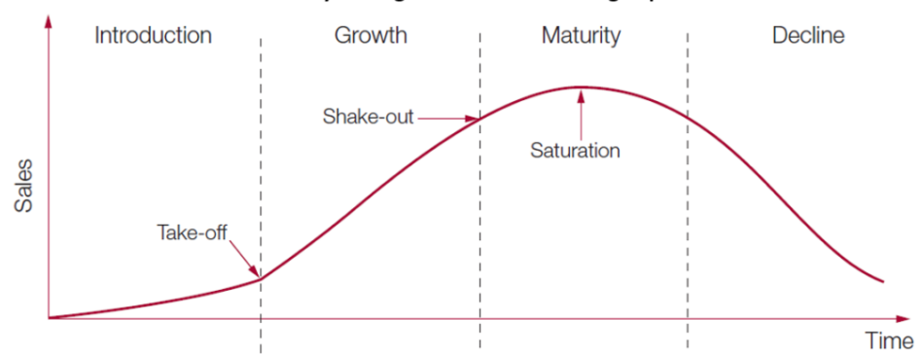
PLC Stages
There are four stages of product development
Introduction
Growth
Maturity
Decline
Notes:
There are four stages of product development; introduction, growth, maturity, and decline as illustrated in the chart
We will discuss each stage in the preceding slides to develop better understanding of the activities involved

Slide 10
Introduction Stage
This is the initial stage of product development. The main goal is to create awareness about the product. It is characterized by low profit, high operating cost, Low sales, little or no competition, and prices are low.
In the introduction stage of Samsung Note series, the company carried vigorous brand awareness, experienced low sales, and high cost of operation.
Notes:
This is the initial stage of product development. The main goal is to create awareness about the product. It is characterized by low profit, high operating cost, Low sales, little or no competition, and prices are low.
In the introduction stage of Samsung Note series, the company carried vigorous brand awareness, experienced low sales, and high cost of operation

Slide 11
Growth Stage
This is the second stage of product development. Here, the product is at peak. The sales are high due to increased customer demand resulting from the vigorous marketing campaign. The company here is to maintain the customer loyalty to the product by continually improving the quality of the product (Toni, 2017).
Samsung has consistently continued to offer quality product in the market that remain competitive. It releases new product every year to match this need.
Therefore, this stage is characterized by High demand, increased sales, increased revenue, competition arises.
Notes:
This is the second stage of product development. Here, the product is at peak. The sales are high due to increased customer demand resulting from the vigorous marketing campaign. The company here is to maintain the customer loyalty to the product by continually improving the quality of the product (Toni, 2017).
Samsung has consistently continued to offer quality product in the market that remain competitive. It releases new product every year to match this need.
Therefore, this stage is characterized by High demand, increased sales, increased revenue, competition arises.

Slide 12
Maturity Stage
At this stage, the customers are fully aware of the product. There is decreased sales due to increased competition. The company needs to develop a strategy to counter the competition.
Characteristic: high level of competition, Customers are fully aware of product, high market share, high profits, and high prices.
Notes:
At this stage, the customers are fully aware of the product. There is decreased sales due to increased competition. The company needs to develop a strategy to counter the competition.
Characteristic: high level of competition, Customers are fully aware of product, high market share, high profits, and high prices.

Slide 13
Decline Stage
It is the last stage and there is decreased sales due to change in customer preference, changes in technology, poor customer service, and low quality product.
The company experiences low sale, low revenue, and high competition.
Notes:
It is the last stage and there is decreased sales due to change in customer preference, changes in technology, poor customer service, and low quality product.
The company experiences low sale, low revenue, and high competition.
At this stage, there few options left for the company
Either sustain the product in the market
Reduce cost involved
Harvest the product and sell to its loyal customers

Slide 14
References
Baker, M. J., & Hart, S. (2016). The Marketing Book. Routledge.
Saaksvuori, A., & Immonen, A. (2008). Product Lifecycle Management. Berlin, Germany: Springer Science & Business Media.
Toni, D. D., Milan, G. S., Saciloto, E. B., & Larentis, F. (2017). Pricing
strategies and levels and their impact on corporate profitability.
Management Review.
Notes:
This work is cited appropriated as shown here

